Slide 1

FLIGHT PRICE PREDICTION
PRESENTED BY:
GAURAV MORE

Slide 2
CONTENTS
INTRODUCTION
PROBLEM STATEMENT
PROBLEM UNDERSTANDING
BENEFITS OF FLIGHT PRICE PREDICTION
DATA ANALYSIS & MODEL BUILDING FLOWCHART
EXPLORATORY DATA ANALYSIS STEPS
VISUALIZATIONS: UNIVARIATE AND BIVARIATE
DATA ANALYSIS STEPS DONE
ASSUMPTIONS
MODEL BUILDING
SAVING THE MODEL AND PREDICTION RESULTS
CONCLUSION

Slide 3
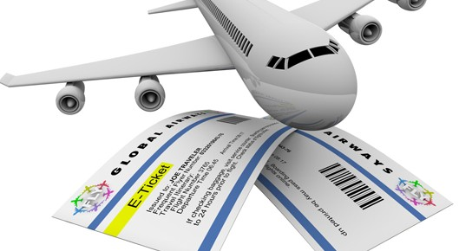
INTRODUCTION
Airline industry is one of the most sophisticated in its use of dynamic pricing strategies to maximize revenue, based on proprietary algorithms and hidden variables. That is why the airline companies use complex algorithms to calculate the flight ticket prices.
There are several different factors on which the price of the flight ticket depends. The seller has information about all the factors, but buyers are able to access limited information only which is not enough to predict the airfare prices. Considering the features such as departure time, arrival time and time of the day it will give the best time to buy the ticket.
Nowadays, the number of people using flights has increased significantly. It is difficult for airlines to maintain prices since prices change dynamically due to different conditions. That’s why we will try to use machine learning models to solve this problem. This can help airlines by predicting what prices they can maintain. It can also help customers to predict future flight prices and plan their journey accordingly.

Slide 4
PROBLEM STATEMENT
Anyone who has booked a flight ticket knows how unexpectedly the prices vary. The cheapest available ticket on a given flight gets more and less expensive over time. This usually happens as an attempt to maximize revenue based on -
1. Time of purchase patterns (making sure last-minute purchases are expensive).
2. Keeping the flight as full as they want it (raising prices on a flight which is filling up in order to reduce sales and hold back inventory for those expensive last-minute expensive purchases).
Business goal: the main aim of this project is to predict the price of flight tickets based on various features. The purpose of the paper is to study the factors which influence the fluctuations in the airfare prices and how they are related to the change in the prices. Then using this information, build a system that can help buyers whether to buy a ticket or not. So, we will deploy an machine learning model for flight ticket price prediction and analysis. This model will provide the approximate selling price for the flight tickets based on different features.

Slide 5
PROBLEM UNDERSTANDING
Airlines implement dynamic pricing for their tickets, and base their pricing decisions on demand estimation models. The reason for such a complicated system is that each flight only has a set number of seats to sell, so airlines have to regulate demand. In the case where demand is expected to exceed capacity, the airline may increase prices, to decrease the rate at which seats fill. On the other hand, a seat that goes unsold represents a loss of revenue, and selling that seat for any price above the service cost for a single passenger would have been a more preferable scenario.
Here we are trying to help the buyers to understand the price of the flight tickets by deploying machine learning models. These models would help the sellers/buyers to understand the flight ticket prices in market and accordingly they would be able to book their tickets.

Slide 6
BENEFITS OF FLIGHT PRICE PREDICTION
Pricing in the airline industry is often compared to a brain game between carriers and passengers where each party pursues the best rates. Carriers love selling tickets at the highest price possible while still not losing consumers to competitors. Passengers are crazy about buying flights at the lowest cost available while not missing the chance to get on board. All this makes flight prices fluctuant and hard to predict. But nothing is impossible for people armed with intellect and algorithms. Predicting flight prices helps an individuals to know and understand the future price of the flight tickets.
There are two main use cases of flight price prediction in the travel industry. Otas and other travel platforms integrate this feature to attract more visitors looking for the best rates. Airlines employ the technology to forecast rates of competitors and adjust their pricing strategies accordingly.
A passenger-side predictor proposed by an OTA suggests the best time to buy a ticket so that travelers can make informed decisions. Carriers, on their end, try to find out the optimal price they should set to maximize revenue while remaining competitive.

Slide 7
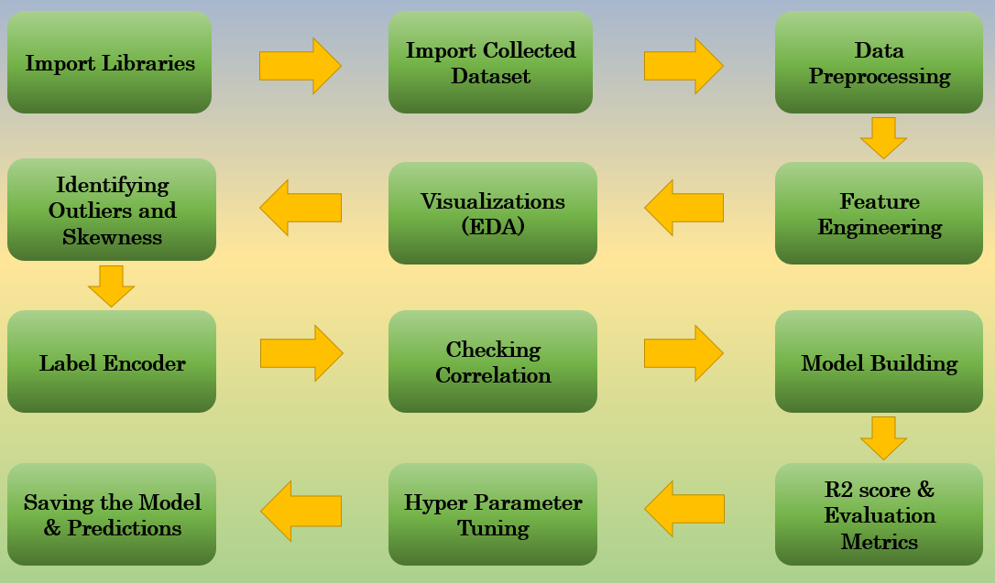
DATA ANALYSIS AND MODEL BUILDING FLOWCHART

Slide 8
EXPLORATORY DATA ANALYSIS (EDA) STEPS
Importing necessary libraries and importing dataset as a data frame.
Checked some statistical information like shape, number of unique values present, info, data types etc.
Taking care of timestamp variables by converting data types of “departure_time” and “time_of_arrival” from object data type into datetime data types.
Done feature engineering on some features as they had some irrelevant values and replaced them with empty spaces.
Extracted proper duration column in terms of float data type from the difference of arrival time and departure time.Extracted departure_hour, deparutre_min and arrival_hour, arrival_min columns from departure_time and time_of_arrival columns and dropped these columns after extraction.
The label “price" should be continuous numeric data but due to some string values like “,” it was showing as object data type. So, I replaced this sign by empty space and converted into float data type.
Grouped same categories in the column meal_availability and converted categorical data into numeric data in number_of_stops column.
Checked for null values and found no missing values in the dataset.
Performed univariate, bivariate and multivariate analysis. Visualized each feature using seaborn and matplotlib libraries by plotting several categorical and numerical plots like pie plot, count plot, bar plot, reg plot, strip plot, line plot, box plot, boxen plot, distribution plot, and pair plot.
Identified outliers using box plots and checked skewness and removed skewness in duration column using sqrt method.
Used pearson’s correlation coefficient to check the correlation between label and features. With the help of heatmap and correlation bar graph was able to understand the feature vs label relativity and insights on multicollinearity amongst the feature columns.

Slide 9
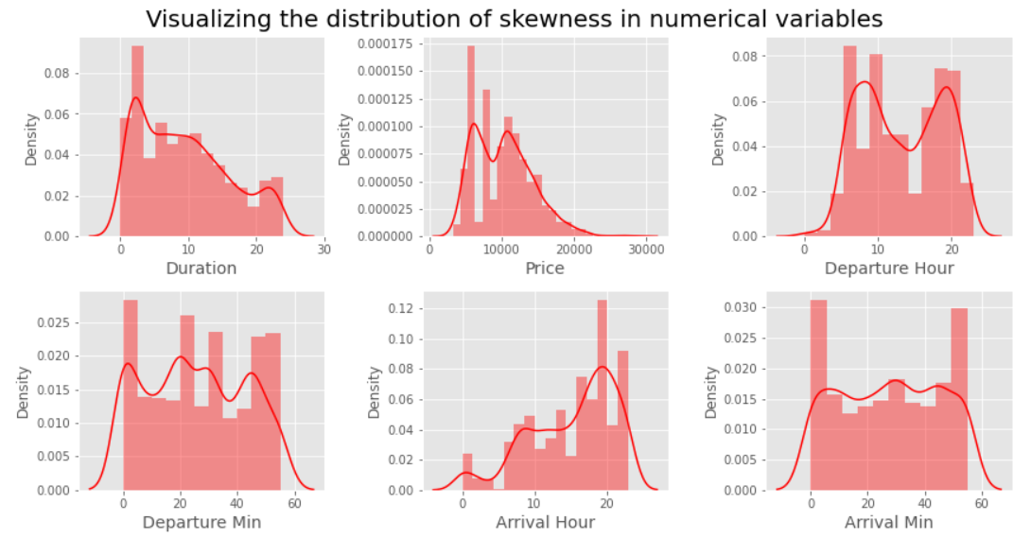
VISUALIZATION :UNIVARIATE ANALYSIS FOR NUMERICAL VARIABLES
The distribution plot shows how the data has been distributed in each of the columns.
From the distribution plot we can observe the columns are somewhat distributed normally as they have no proper bell shape curve.
The columns like "duration“ and "price" are skewed to right as the mean value in these columns are much greater than the median(50%).
Also the data in the column arrival hour skewed to left since the mean values is less than the median.
Since there is presence of skewness in the data, we need to remove skewness in the numerical columns to overcome with any kind of data biasness.

Slide 10
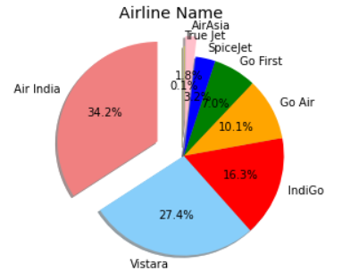
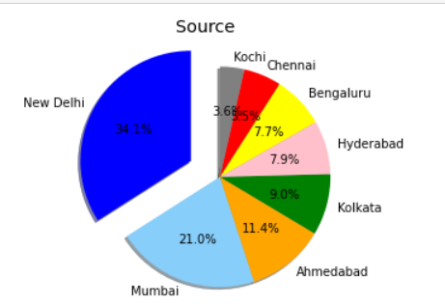
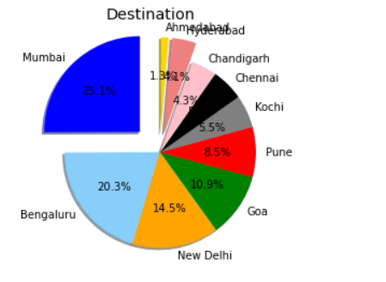
UNIVARIATE ANALYSIS: VISUALIZING COUNTS OF CATEGORICAL VARIABLES

Slide 11
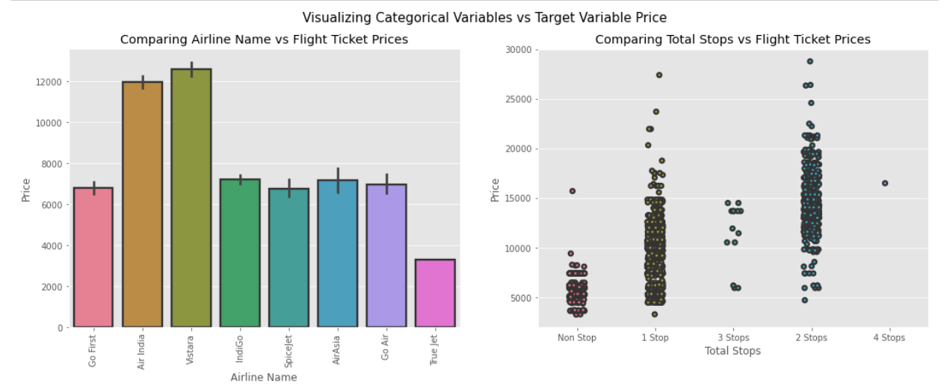
BIVARIATE ANALYSIS: VISUALIZING CATEGORICAL VARIABLES VS PRICE
Airline vs Price: From the bar plot we can notice "Vistara" and "Air India" airlines have highest ticket prices compared to other airlines.
Total Stops vs Price: From the strip plot we can notice the flights which have 1 and 2 stops between source and destination have highest ticket prices compared to others. The airlines which have 4 stops during the journey have very less ticket price. So we can say as the stops increases, ticket price decreases.

Slide 12
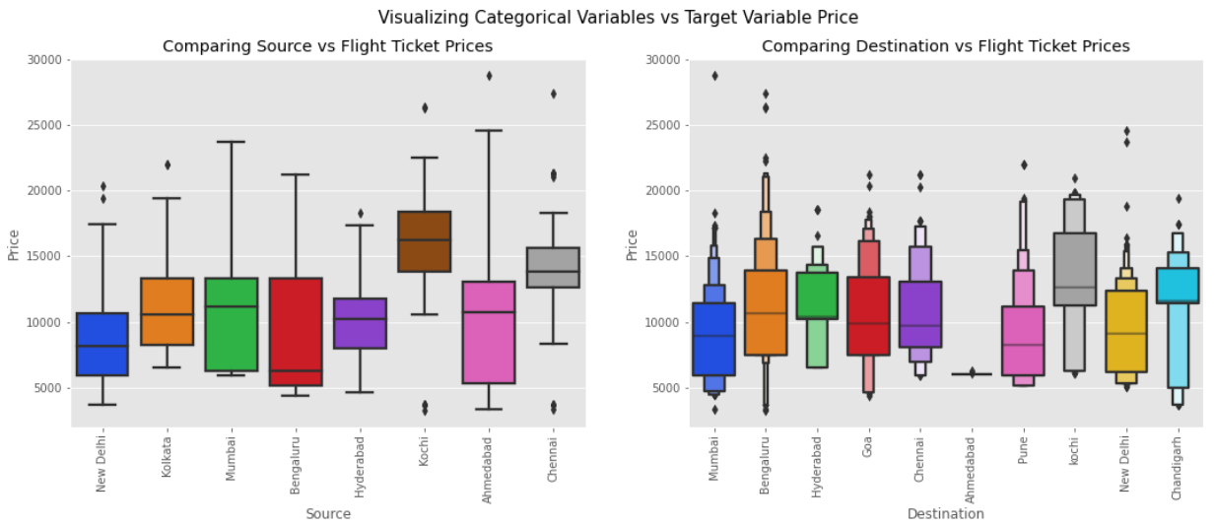
BIVARIATE ANALYSIS: VISUALIZING CATEGORICAL VARIABLES VS PRICE
Source vs Price: From the box plot we can observe the flights from Kochi are having somewhat higher prices compared to other sources
Destination vs Price: From the boxen plot we can notice that the flights travelling to Bengaluru have higher flight ticket prices.

Slide 13
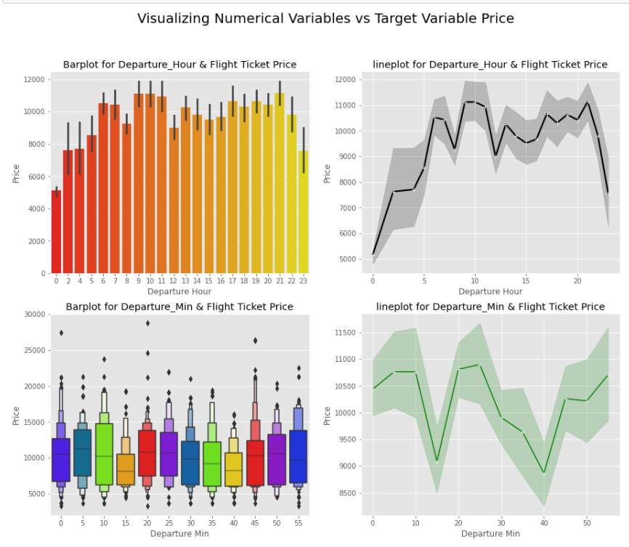
BIVARIATE ANALYSIS: VISUALIZING NUMERICAL VARIABLES VS PRICE
Departure Hour vs price: from the bar plot and line plot we can see that there are some flights departing in the early morning 3 AM having most expensive ticket prices compared to late morning flights. We can also observe the flight ticket prices are higher during afternoon (may fluctuate) and it decreases in the evening.
Departure Min vs price: the boxen plot and line plot gives there is no significant difference between price and departure min.

Slide 14
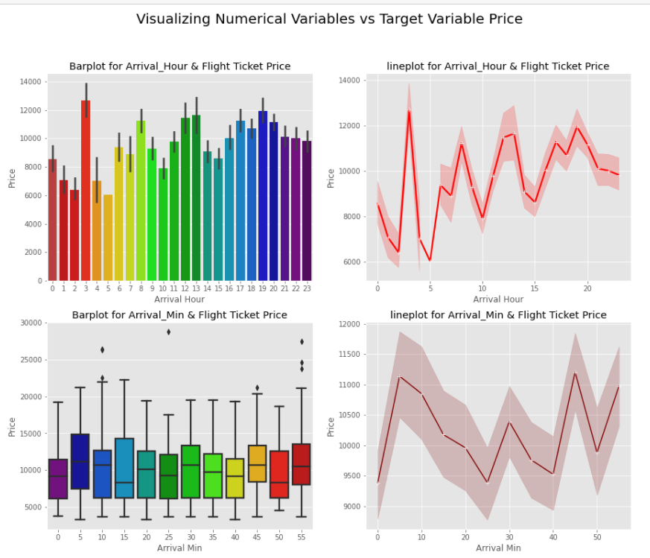
BIVARIATE ANALYSIS: VISUALIZING NUMERICAL VARIABLES VS PRICE
Arrival Hour vs price: from the bar plot and line plot we can observe that very few flights are arriving in the early morning that is 0 to 6 AM they have very less ticket price. Also, the flights which are arriving in the afternoon and evening have somewhat higher price. So, we can conlude this column has some positive correlation with price.
Arrival Min vs price: there is no significant difference between this feature and price. We can say flight ticket prices are not much dependent on the arrival_min.

Slide 15
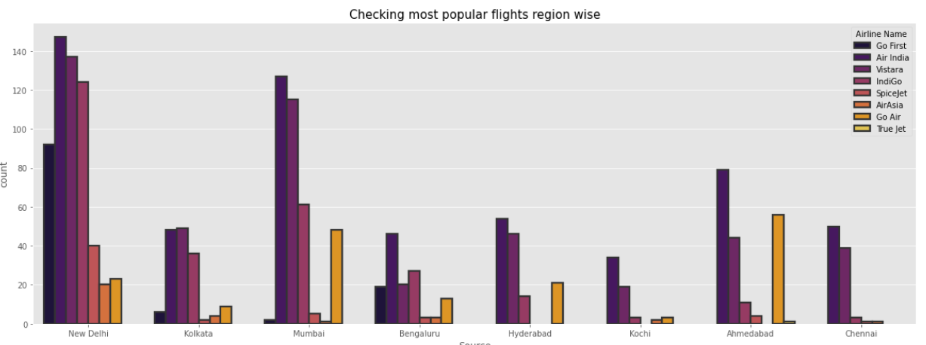
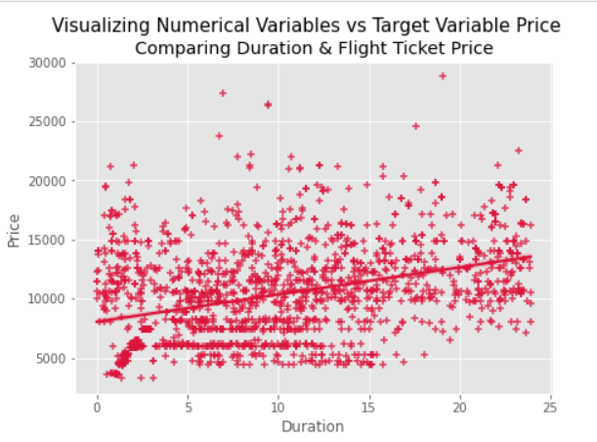
BIVARIATE ANALYSIS
Duration vs Price: From the reg plot we can observe some positive linear relation between Duration and Price. Flights having 1-12 hours of duration, they have ticket price of around 15000.
Source vs Price:The plot showing the region wise count of airlines shows that New Delhi, Kolkata, Mumbai and Bengaluru Source is not having True jet flight, Hyderabad source is not having Go First, SpiceJet,AirAsia and True Jet flights, Kochi is not having Go First,SpiceJet and True jet flights, Ahmedabad is not having Go FirstAirAsia flights, Chennai is not having Go First,Go Air and True jet flights. Air India flights are in higher count in almost all the regions except Kolkata. Kolkata has Vistara flights in higher count.

Slide 16
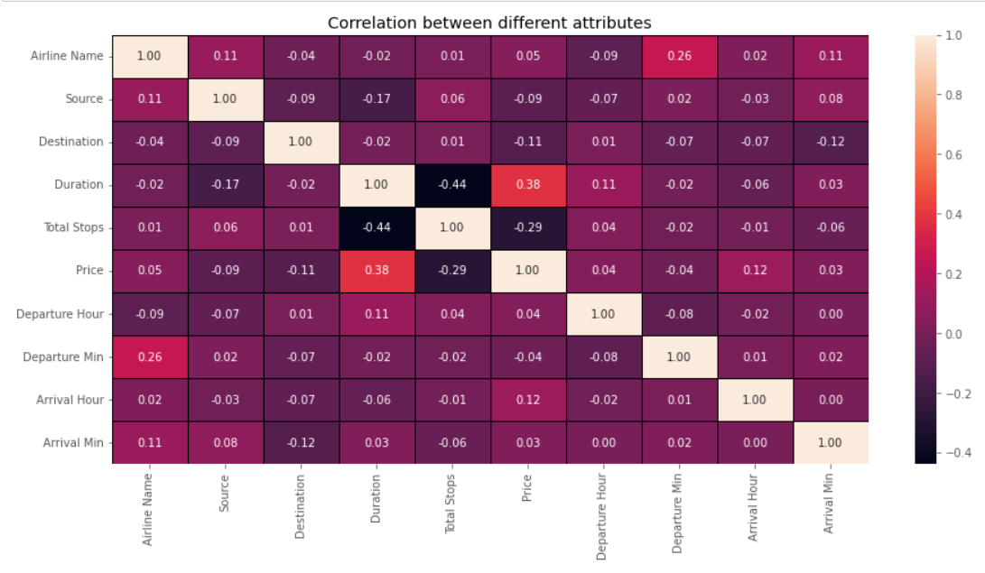
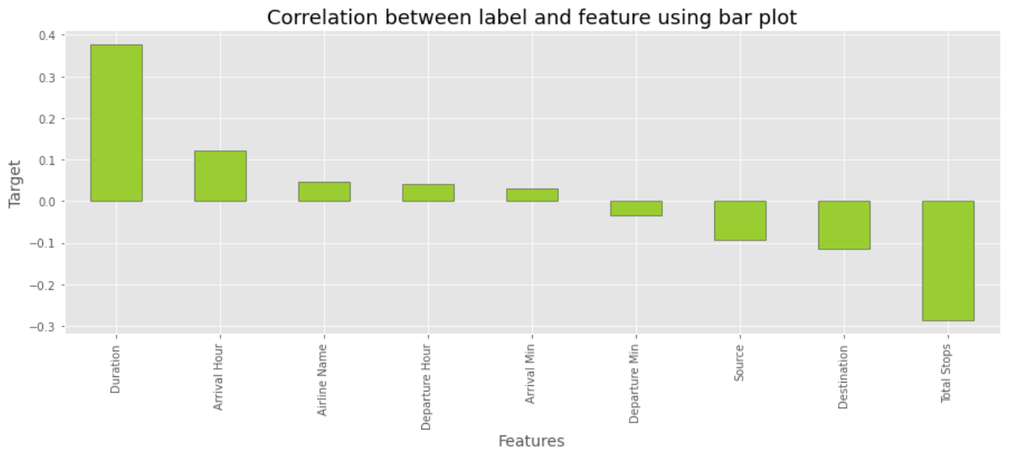
CORRELATION BETWEEN FEATURES AND LABEL
From the heat map and bar plot we can clearly observe the positive and negative correlation between the label and features. From the heat map we can notice that the light shades are highly positively correlated and dark shades are highly negatively correlated with the target variable.

Slide 17
DATA ANALYSIS STEPS
I have done feature engineering steps like feature extraction and feature selection to improve data normality and linearity.
Identified outliers using boxplots and found no outliers in numerical variables.
Identified skewness using distribution plots and removed skewness using square root transformation method.
Used pearson’s correlation coefficient to check the correlation between dependent and independent variables. To visualize the correlation I have used heatmap and bar plot.
I have used standardscalar method to scale the data to overcome with the issue of data biasness.
Split train and test to build machine learning models. Found best random state and best accuracy. Model building process will be shown in the further steps.

Slide 18
ASSUMPTIONS
Firstly, from the problem statement we got to know that it is a regression type problem for which we used regression algorithms to build the model and predicted the price of flight tickets by collecting the from yatra website using web scraping.
Secondly, from the distribution plots i found skewness in duration column and from box plots i found outliers in target column and categorical column. Also, based upon the analysis and visualization part we have seen some of the features having somewhat linear relation with label. So, I assumed these features helps in model building and to predict price of the flight tickets. Also, this model helps the buyers to understand the future price of the flight tickets.
So, i suggest that the sellers and buyers take this model into consideration the features that were deemed as most important as seen in this study might help them estimate the flight ticket price.

Slide 19
MODEL BUILDING
In this problem “price” is our target variable which is continuous in nature where we need to predict the price of flight tickets. From this I can conclude that it is a regression type problem hence I have used following regression algorithms.
After the pre-processing and data cleaning i left with 11 columns including target and with the help of feature importance bar graph i used these independent features for model building and prediction. The algorithms used on training the data are as follows:
Linear Regression
Lasso Regressor
Ridge Regressor
Decision Tree Regressor
KNeighbors Regressor
Support Vector Regressor
Random Forest Regressor
Ada Boost Regressor
Gradient Boosting Regressor
Extreme Gradient Boosting (XGB)Regressor
Stochastic Gradient Descent (SGD) Regressor

Slide 20
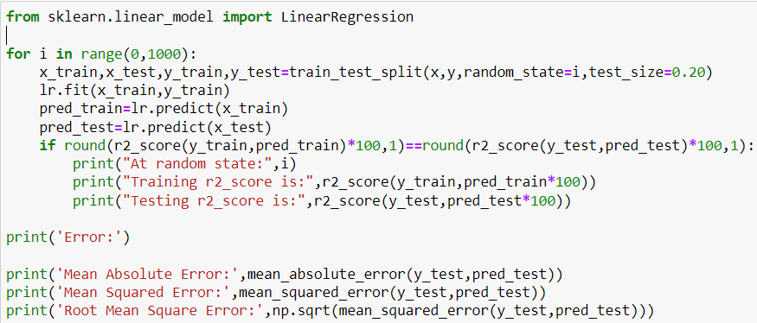
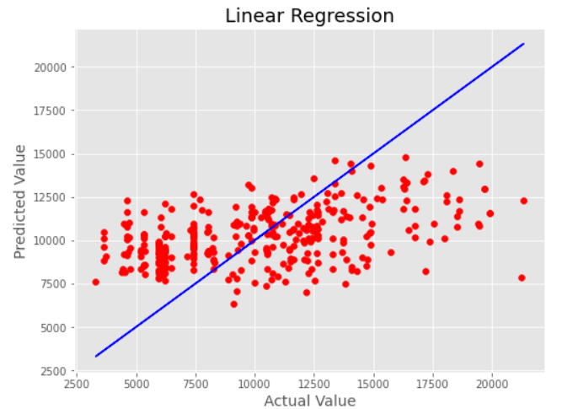
LINEAR REGRESSION
LINEAR REGRESSION IS A MACHINE LEARNING ALGORITHM BASED ON SUPERVISED LEARNING. IT IS A MODEL THAT ASSUMES A LINEAR RELATIONSHIP BETWEEN THE INPUT VARIABLES (X) AND THE SINGLE OUTPUT VARIABLE (Y) I.E Y=BX+C
Created Linear Regression model and checked for its evaluation metrics. The model is giving R2 score as -68136.05710272539%.
From the graph we can observe how our model is mapping. In the graph we can observe the straight line which is our actual dataset and dots are the predictions that the model has given.

Slide 21
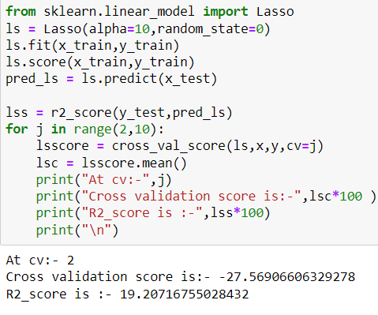
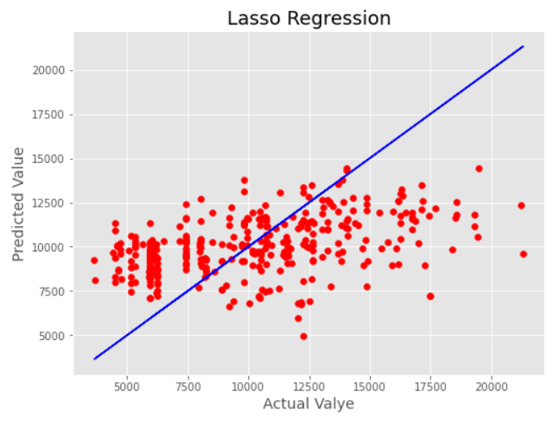
LASSO REGRESSOR
Least absolute shrinkage and selection operator (lasso) is a regression technique. Lasso is a powerful technique that performs regularisation and feature selection. In lasso instead of squaring the slope like ridge regression, the absolute value of the slope is added as a penalty term.
Created Lasso Regressor model and checked for its evaluation metrics. The model is giving R2 score as 19.20%.
From the graph we can observe how our model is mapping. In the graph we can observe the straight line which is our actual dataset and dots are the predictions that the model has given.

Slide 22
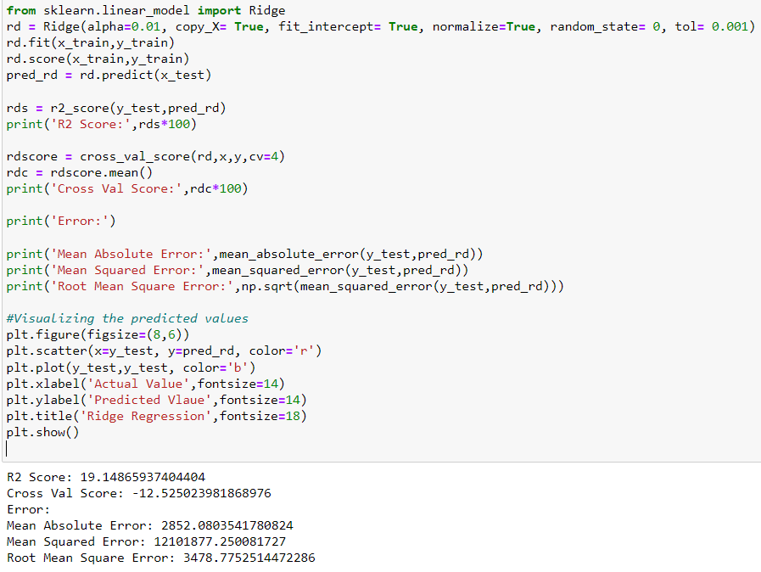
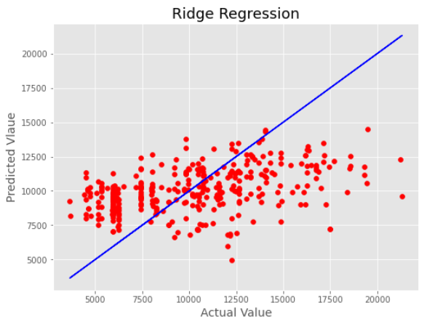
RIDGE REGRESSOR
The ridge regression is supervised regression technique. It is an estimation procedure to manage collinearity without removing variables from the regression model. In multiple linear regression, the multicollinearity is a common problem that leads least square estimation to be unbiased, and its variances are far from the correct value. Therefore, by adding a degree of bias to the regression model, ridge regression reduces the standard errors, and it shrinks the least square coefficients towards the origin of the parameter space.
Created Ridge Regressor model and checked for its evaluation metrics. The model is giving R2 score as 19.14%.
From the graph we can observe how our model is mapping. In the graph we can observe the straight line which is our actual dataset and dots are the predictions that the model has given.

Slide 23
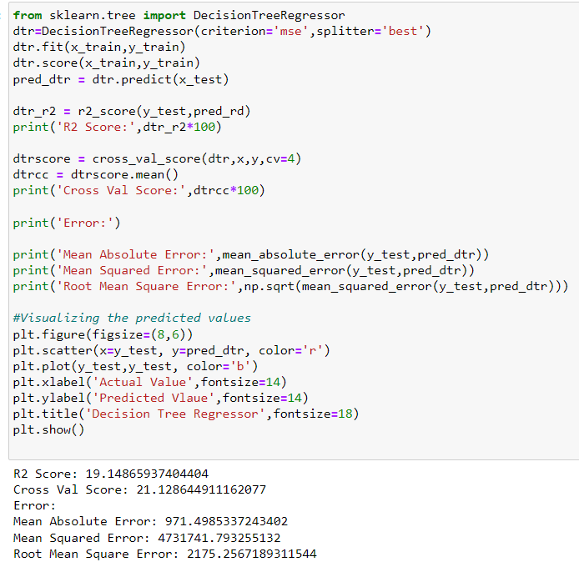
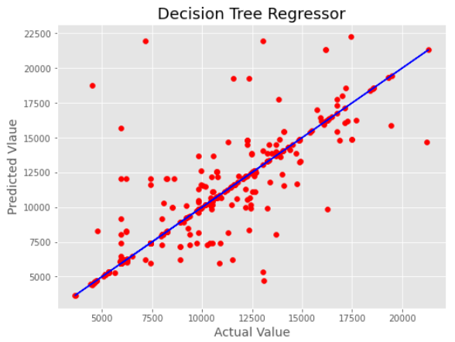
DECISION TREE REGRESSOR
Decision tree regressor is a decision-making tool that uses a flowchart like tree structure. It observes features of an object and trains a model in the structure of a tree to predict data in the future to produce meaningful continuous output.
Created Decision Tree Regressor model and checked for its evaluation metrics. The model is giving R2 score as 19.14%.
From the graph we can observe how our model is mapping. In the graph we can observe the straight line which is our actual dataset and dots are the predictions that the model has given.

Slide 24
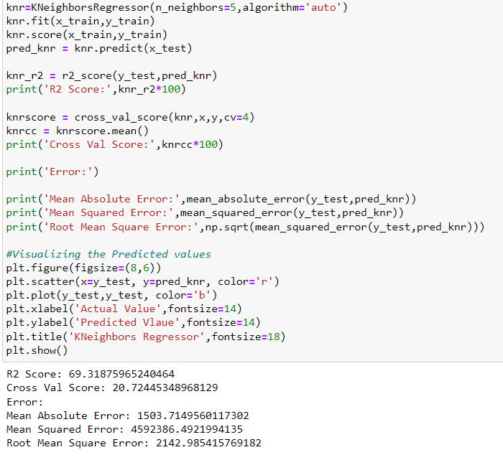
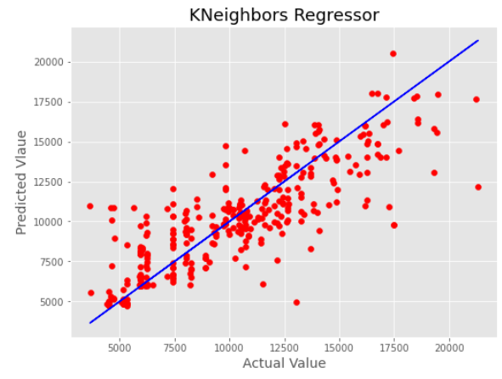
KNEIGHBORS REGRESSOR
Kneighbors regressor is a supervised regression technique based on k-nearest neighbors. The target is predicted by local interpolation of the targets associated of the nearest neighbors in the training set.
Created KNeighbors Regressor model and checked for its evaluation metrics. The model is giving R2 score as 69.31%.
From the graph we can observe how our model is mapping. In the graph we can observe the straight line which is our actual dataset and dots are the predictions that the model has given.

Slide 25
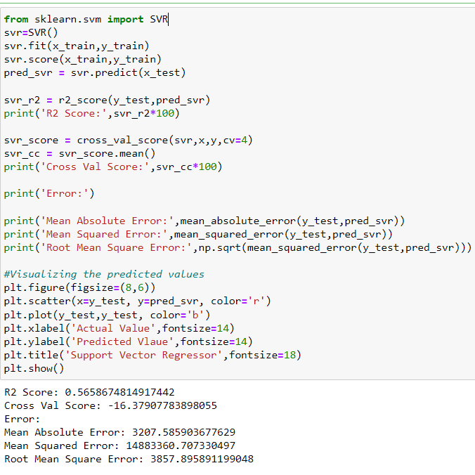
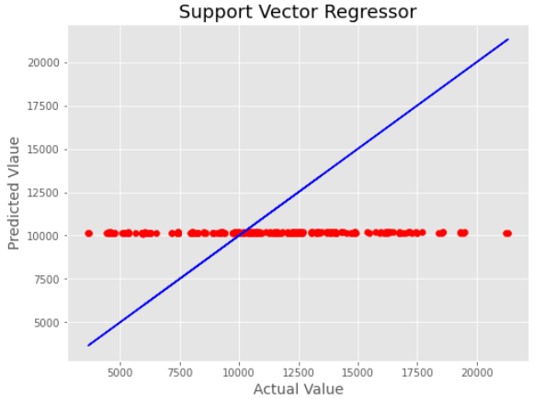
SUPPORT VECTOR REGRESSOR
Support-vector machine constructs a hyperplane or set of hyperplanes in a high- or infinite-dimensional space, which can be used for regression, classification or other tasks like outliers detection. Intuitively, a good separation is achieved by the hyperplane that has the largest distance to the nearest training-data point of any class (so-called functional margin), since in general the larger the margin, the lower the generalization error of the regressor.
Created Support Vector Regression model and checked for its evaluation metrics. The model is giving R2 score as 0.5658%.
From the graph we can observe how our model is mapping. In the graph we can observe the straight line which is our actual dataset and dots are the predictions that the model has given.

Slide 26
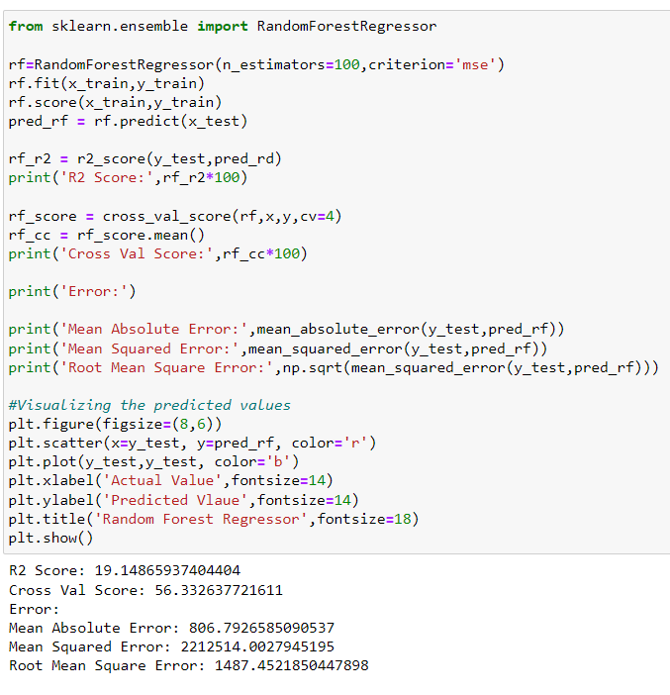
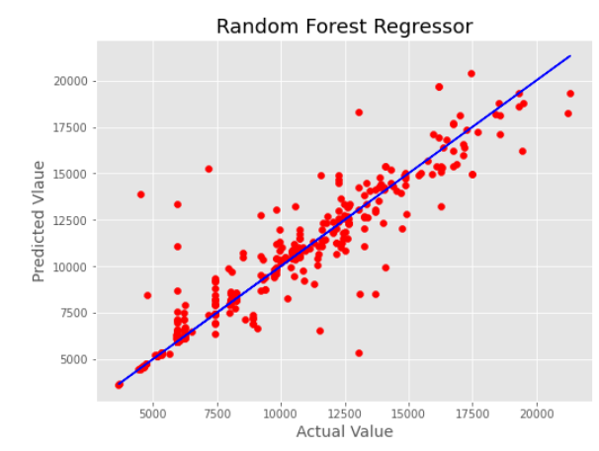
RANDOM FOREST REGRESSOR
Random forest regressor is an ensemble technique capable of performing both regression and classification tasks with use of multiple decision trees and a technique called bootstrap aggregation. It improves the predictive accuracy and control over-fitting.
Created Random Forest Regressor model and checked for it evaluation metrics. The model is giving R2 score as 19.14%.
From the graph we can observe how our model is mapping. In the graph we can observe the straight line which is our actual dataset and dots are the predictions that our model has given.

Slide 27
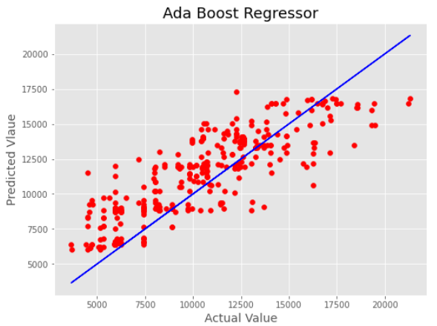
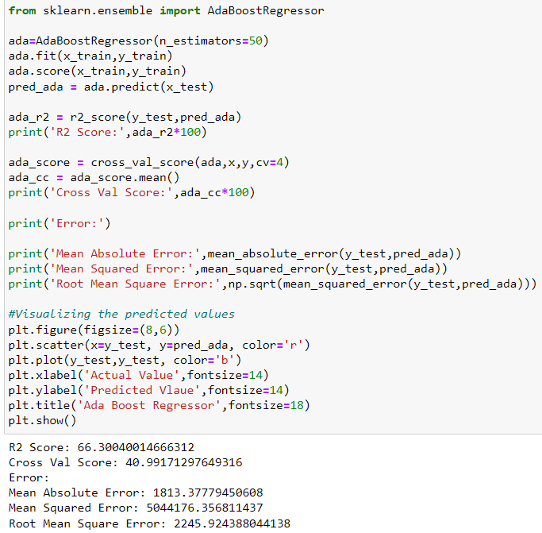
ADA BOOST REGRESSOR
An adaboost regressor is a meta-estimator that begins by fitting a regressor on the original dataset and then fits additional copies of the regressor on the same dataset but where the weights of instances are adjusted according to the error of the current prediction.
Created Ada Boost Regressor model and checked for its evaluation metrics. The model is giving R2 score as 66.30%.
From the graph we can observe how our model is mapping. In the graph we can observe the straight line which is our actual dataset and dots are the predictions that our model has given.

Slide 28
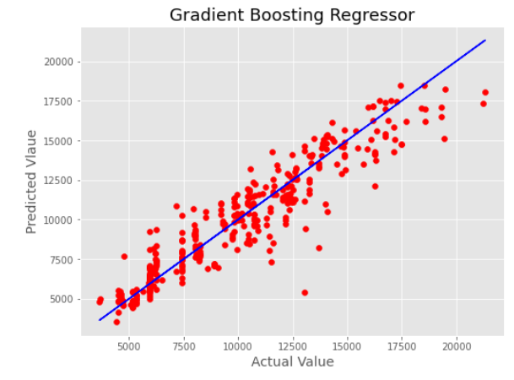
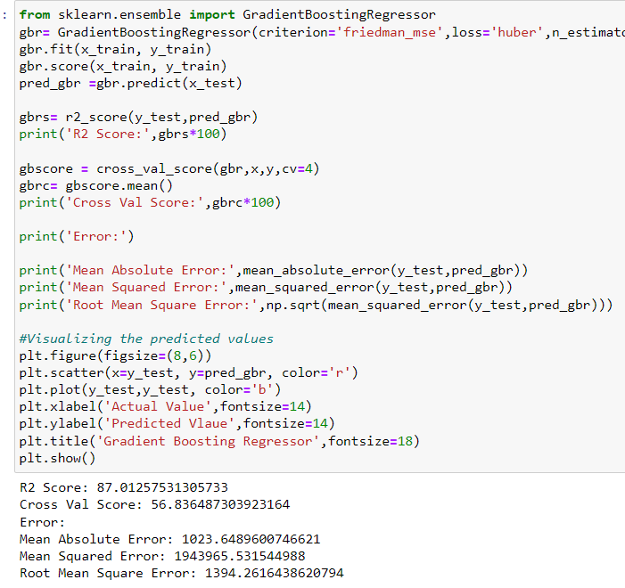
GRADIENT BOOSTING REGRESSOR
Gradient boosting regressor is also works for both numerical as well as categorical output variables. It produces a prediction model in the form of an ensemble of weak prediction models, typically decision trees. This model was chosen to account for non-linear relationships between the features & predicted price, by splitting the data into 100 regions.
Created Gradient Boosting Regressor model and checked for its evaluation metrics. The model is giving R2 score as 87.01%.
From the graph we can observe how our model is mapping. In the graph we can observe the straight line which is our actual dataset and the dots are the predictions that our model has given.

Slide 29
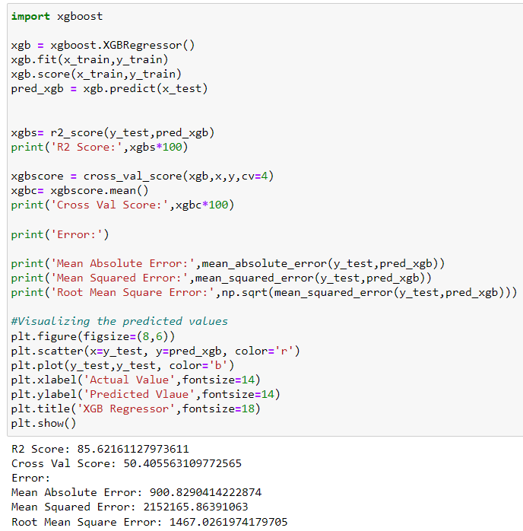
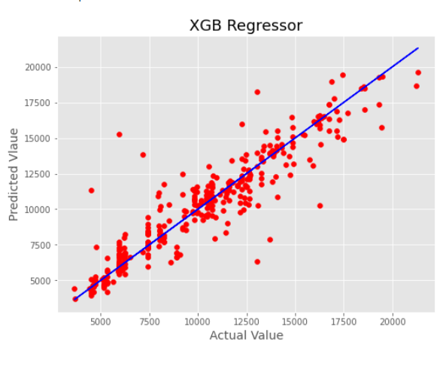
EXTREME GRADIENT BOOSTING (XGB) REGRESSOR
XGB regressor is a popular supervised machine learning model and it is an implementation of gradient boosting trees algorithm. It is best known to provide better solutions than other machine learning algorithms.
Created XGB Regressor model and checked for its evaluation metrics. The model is giving R2 score as 85.62%.
From the graph we can observe how our model is mapping. In the graph we can observe the straight line which is our actual dataset and the dots are the predictions that our model has given.

Slide 30
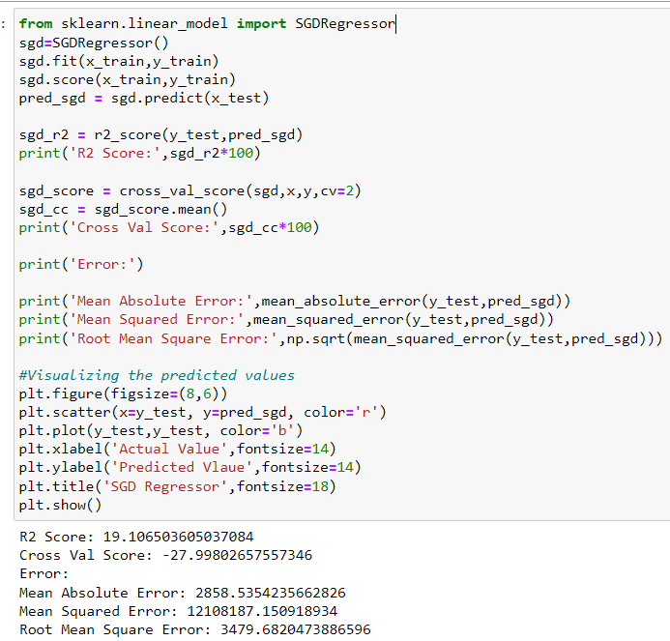
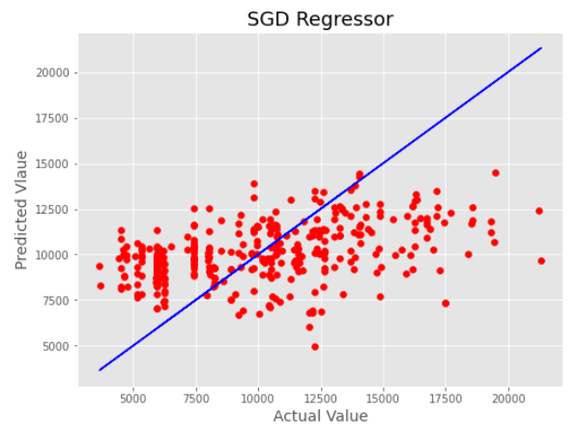
STOCHASTIC GRADIENT DESCENT (SGD) REGRESSOR
The sgdregressor implements a plain stochastic gradient descent learning routine which supports different loss functions and penalties to fit linear regression models. Sgdregressor is well suited for regression problems with a large number of training samples.
Created SGDRegressor model and checked for its evaluation metrics. The model is giving R2 score as 19.10%.
From the graph we can observe how our model is mapping. In the graph we can observe the straight line which is our actual dataset and the dots are the predictions that our model has given.

Slide 31

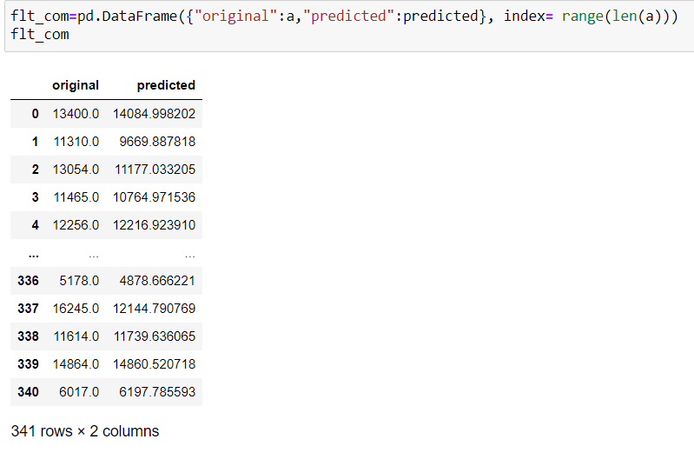
SAVING THE SELECTED MODEL
MODEL SELECTION:
From the above created models, we can conclude that “gradient boosting regressor” as the best fitting model as it is giving high R2 score and low MAE, MSE and RMSE values.
MODEL SAVING:
PREDICTION FROM SAVED MODEL:

Slide 32
CONCLUSION
The case study aims to give an idea of applying machine learning algorithms to predict the price of the flight tickets. After the completion of this project, we got an insight of how to collect data, pre-processing the data, analyze the data, cleaning the data and building a model.
First we collected the flights data from websites like www.yatra.com, www.makemytrip.com, www.tripodeal.com, www.vimaansafar.com and it was done by using web scraping. The framework used for web scraping was selenium, which has an advantage of automating our process of collecting data. We collected almost 1712 of data which contained the ticket price of the flights and other related features. Then, the scrapped data was saved in a excel file so that we can use further and analyze the data.
Then we loaded the dataset and have done data cleaning, eda process and pre-processing techniques like checking outliers, skewness, correlation, scaling data etc. And got better insights from data visualization.
From the visualizations we got to know that flight ticket prices change during morning and evening time of the day. From the distribution plots we came to know that the prices of the flight tickets are going up and down, they are not fixed at a time. Also, from this graph we found prices are increasing in large amounts. Also from categorical and numerical plots we found that the prices are tending to go up as the time is approaching from morning to evening. From the categorical plots (bar and box) we came to know that early morning and late night flights are cheaper compared to working hours. From the categorical plots we found that the flight ticket prices increases as the person get near to departure time. That is last minute flights are very expensive. From the bar plot we got to know that both indigo and spicejet airways almost having same ticket fares.
After separating our train and test data, we started running different ml regression algorithms to find out the best performing model on the basis of different metrics like r2 score mae, mse, rmse. We got Gradient Boosting regressor as the best model among all the models.

Slide 33


